Slide 1
Introduction to Neural Networks
Deep Learning Course
GitHub Link

Slide 2
Artificial Neural Networks (ANNs)
What are Neural Networks?
Neural networks are a subset of machine learning and are at the heart of deep learning algorithms.
They are inspired by the structure and function of the brain, particularly its network of neurons.
Artificial Neural Networks are computational models designed to recognize patterns, make predictions, and perform complex tasks. They consist of layers of interconnected artificial neurons.

Slide 3
Definition
ANNs are networks of interconnected neurons organized into layers: an input layer, one or more hidden layers, and an output layer.
Input Layer: Receives the initial data (features).
Hidden Layers: Intermediate layers where computations and feature transformations occur.
Output Layer: Produces the final result (predictions or classifications).

Slide 4
Purpose
Pattern Recognition: ANNs can identify patterns and relationships in data that may not be easily apparent.
Prediction: Used for forecasting future events or values based on historical data.
Classification: Categorize data into predefined classes or groups.
Function Approximation: Model complex functions or mappings from inputs to outputs.

Slide 5
Evolution of Neural Networks in AI
The concept of neural networks dates back to the 1940s, but their development has seen significant milestones:
Early Research:
1943: Warren McCulloch and Walter Pitts proposed the first model of a neural network.
1958: Frank Rosenblatt developed the Perceptron, an early neural network model capable of binary classification.

Slide 6
Development and Challenges
1960s-1980s: Research faced challenges due to limitations in computational power and the complexity of training networks.
1986: The introduction of the Backpropagation algorithm by Rumelhart, Hinton, and Williams revitalized interest in neural networks by improving the training process.

Slide 7
Modern Advancements
1990s-2000s: Emergence of deep learning, leveraging larger datasets and advanced hardware to train deeper and more complex networks.
2010s-Present: Breakthroughs in deep learning, such as Convolutional Neural Networks (CNNs) and Transformer models, have driven advancements in AI applications, including image recognition, natural language processing, and autonomous systems.

Slide 8
Motivation
Biological Inspiration: The human brain's ability to learn and adapt has been a major source of inspiration. Artificial neural networks (ANNs) attempt to replicate this biological process to solve complex tasks.
Pattern Recognition: ANNs are particularly effective in recognizing patterns and making predictions, which are essential for tasks such as image and speech recognition, natural language processing, and more.

Slide 9
Comparison with Traditional Models
Traditional Machine Learning Models:
Models like linear regression, decision trees, and support vector machines (SVM) are powerful but often require feature engineering and may not perform well on complex tasks.
Neural Networks:
Neural networks can automatically learn features from raw data, which is particularly useful for tasks involving high-dimensional data like images, audio, and text.
They can model complex relationships and interactions within data, which traditional models might miss.

Slide 10

Basic Structure: Neurons, Layers
Neurons
Anatomy of a Neuron:
A neuron in an ANN (Artificial Neural Networks) consists of several inputs, each associated with a weight, a bias term, and an activation function.
The output of a neuron is calculated as follows:
Where σ\sigmaσ is the activation function, wi​ are the weights, xi​ are the inputs, and b is the bias.

Slide 11
Mathematical Representation:
Inputs (xi​): The features or data fed into the neuron.
Weights (wi​): Parameters that adjust the input's significance.
Bias (b): An additional parameter that allows the activation function to be shifted left or right.
Activation Function (σ): Determines the output of the neuron based on the weighted sum of inputs plus bias.

Slide 12
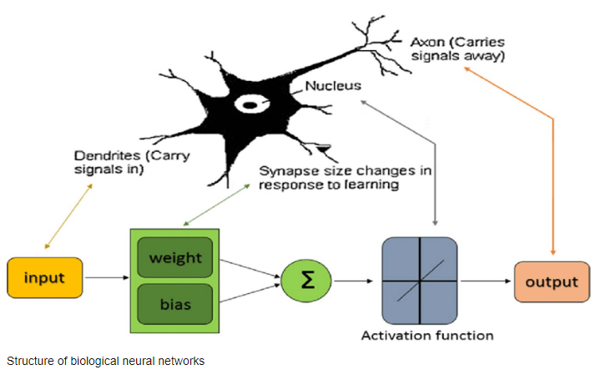

Slide 13
Layers
Types of Layers:
Input Layer: The first layer in a neural network, where data is fed into the network. Each neuron in this layer represents a feature in the input data.
Hidden Layers: Layers between the input and output layers. They perform computations and learn complex patterns by transforming the input data through multiple layers of neurons.
Output Layer: The final layer that produces the network's prediction or output. The number of neurons in this layer depends on the nature of the task (e.g., classification, regression).

Slide 14
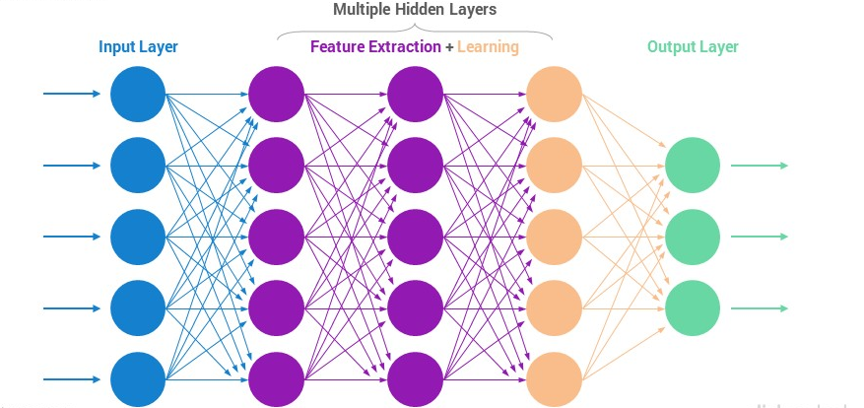
Neural Network Structure

Slide 15
Role and Function:
Input Layer: Simply passes the data into the network without transformation.
Hidden Layers: Apply weights and activation functions to inputs, enabling the network to learn from the data.
Output Layer: Transforms the processed data from the hidden layers into the final output.

Slide 16
Activation Functions
Purpose of Activation Functions
Linearity vs. Non-Linearity:
Without activation functions, neural networks would only be able to learn and represent linear relationships. Activation functions introduce non-linearity, allowing the network to learn more complex patterns and functions.
Transformations: Activation functions transform the input signal into an output signal for the next layer. They help the network learn from data by deciding which neurons should be activated.

Slide 17

Common Activation Functions
1. Sigmoid Function:
Properties:
Output range: (0, 1)
Smooth gradient
Used in binary classification problems

Slide 18
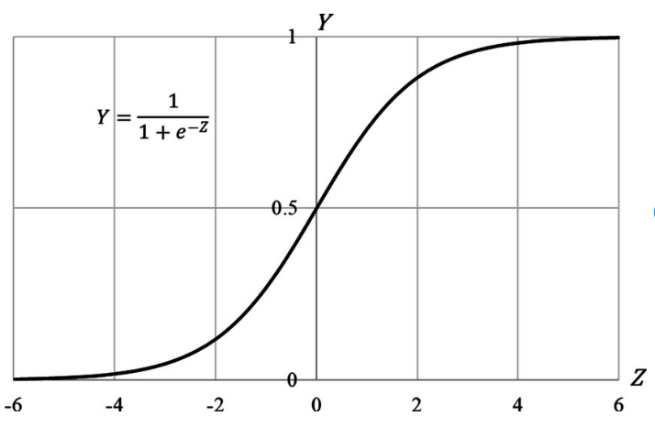
Drawbacks
Vanishing gradient problem in deep networks
Not zero-centered, which can slow down training

Slide 19

2. Rectified Linear Unit (ReLU) Function
Formula
Properties:
Output range: [0, ∞)
Computationally efficient
Helps with the vanishing gradient problem
Drawbacks:
Can suffer from the "dying ReLU" problem where neurons get stuck during training

Slide 20
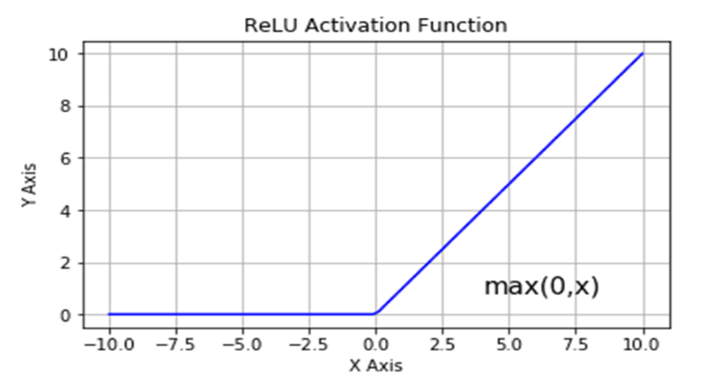
ReLU graph

Slide 21

3. Hyperbolic Tangent (Tanh) Function
Range: (-1, 1)
Use Case: Commonly used in hidden layers; it centers the data around zero.
Pros: Output values centered around zero, reducing bias in the gradients.
Cons: Can also suffer from vanishing gradients, but less severe than sigmoid.

Slide 22
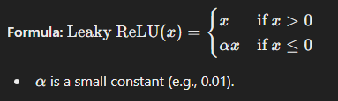
4. Leaky Rectified Linear Unit (Leaky ReLU)
Range: (-∞, ∞)
Use Case: Alternative to ReLU to address the dying ReLU problem.
Pros: Allows a small, non-zero gradient when x≤0, which helps with training.
Cons: Still susceptible to issues with large negative values.

Slide 23
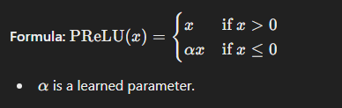
5. Parametric Rectified Linear Unit (PReLU)
Range: (-∞, ∞)
Use Case: Similar to Leaky ReLU, but α\alphaα is learned during training.
Pros: Adaptively learns the slope for negative values, potentially improving performance.
Cons: Adds additional parameters to the model, increasing complexity.

Slide 24

6. Softmax
Range: (0, 1), with all output values summing to 1.
Use Case: Typically used as the output activation function for multi-class classification problems.
Pros: Provides probabilistic interpretation for classification tasks.
Cons: Can be sensitive to outliers and may lead to vanishing gradients in certain cases.

Slide 25
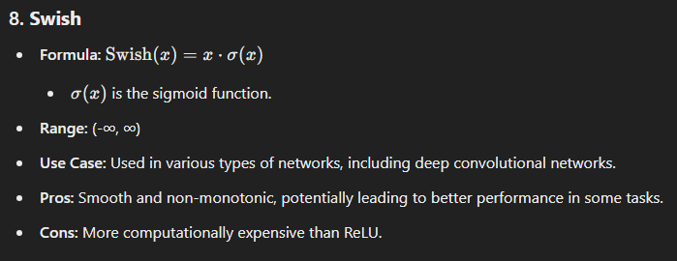

Slide 26
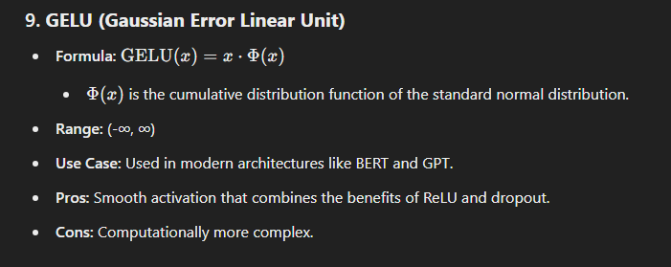

Slide 27
Differences between ANNs and Traditional Machine Learning Models
Data Processing
Traditional ML Models: Often require extensive feature engineering, where domain experts manually create features from raw data to improve model performance.
ANNs: Capable of automatic feature extraction, especially in deep learning where hidden layers learn to represent data at multiple levels of abstraction.

Slide 28
Model Complexity
Traditional ML Models: Typically involve simpler models like linear regression, decision trees, or SVMs. These models are interpretable but may struggle with complex data.
ANNs: Can model highly complex relationships due to their multi-layer structure and non-linear activation functions.

Slide 29
Performance on Large Datasets
Traditional ML Models: Performance may plateau or degrade as the dataset size increases due to limited model complexity.
ANNs: Often improve in performance with larger datasets as they can learn more intricate patterns.

Slide 30
Training Time
Traditional ML Models: Generally faster to train, especially for smaller datasets.
ANNs: Typically require more computational resources and time to train, particularly for deep networks.

Slide 31
Interpretability
Traditional ML Models: Easier to interpret and understand the decision-making process.
ANNs: Often considered black boxes, making it difficult to interpret how decisions are made.

Slide 32
Advantages of Using Neural Networks
Automatic Feature Extraction:
Advantage: Reduces the need for manual feature engineering. Deep layers in ANNs automatically learn useful representations of the input data.
Handling Non-Linear Relationships:
Advantage: ANNs can capture complex, non-linear relationships in data, making them suitable for a wide range of tasks.
Scalability:
Advantage: Neural networks can scale with increased data and computational power, often leading to better performance on large datasets.

Slide 33
Versatility:
Advantage: Applicable to various types of data, including images, text, audio, and more, thanks to specialized architectures like CNNs for images and RNNs for sequential data.
Improved Accuracy:
Advantage: When properly trained and tuned, ANNs often achieve higher accuracy compared to traditional models, particularly on complex tasks.
Adaptability:
Advantage: Capable of adapting to new types of data and evolving as new techniques and architectures are developed.

Slide 34
Examples of Tasks Suitable for ANNs
1. Image Recognition and Classification:
Example: Convolutional Neural Networks (CNNs) are used in applications like facial recognition, object detection, and medical image analysis.
2. Natural Language Processing (NLP):
Example: Recurrent Neural Networks (RNNs) and Transformer models are used for tasks such as language translation, sentiment analysis, and text generation.
3. Speech Recognition:
Example: ANNs are employed in voice assistants, transcription services, and speech-to-text applications.

Slide 35
4. Time Series Prediction:
Example: RNNs and Long Short-Term Memory (LSTM) networks are used for forecasting stock prices, weather prediction, and demand forecasting.
5. Reinforcement Learning:
Example: Neural networks are used in reinforcement learning for training agents in environments like gaming, robotics, and autonomous driving.
6. Generative Models:
Example: Generative Adversarial Networks (GANs) are used for generating realistic images, video, and even music.

